Slide 1
Profile Analysis
Intro and Assumptions
Psy 524
Andrew Ainsworth
Psychology Department
California State University, Northridge

Slide 2
Profile Analysis
Profile analysis is the repeated measures extension of MANOVA where a set of DVs are commensurate (on the same scale).

Slide 3
Profile Analysis
The common use is where a set of DVs represent the same DV measured at multiple time points
Used in this way it is the multivariate alternative to repeated measures or mixed ANOVA
The choice often depends on the number of subjects, power and whether the assumptions associated with within subjects ANOVA can be met (e.g. sphericity)

Slide 4
Repeated Measures Data

Slide 5
Profile Analysis
The less common use is to compare groups on multiple DVs that are commensurate (e.g. subscales of the same inventory)
Current stat packages can be used to perform more complex analyses where there are multiple factorial between subjects effects

Slide 6
Commensurate Data

Slide 7
Questions asked by profile analysis
There is one major question asked by profile analysis; Do groups have similar profiles on a set of DVs?

Slide 8
Questions
Usually in application of profile analysis a researcher is trying to show that groups are not different, that is why most tests are named after the “null” case.

Slide 9
Questions
Segments – difference scores (or other linear combinations) between adjacent DV scores that are used in two of the major tests of profile analysis

Slide 10
Questions
Between Subjects (univariate) – “Equal Levels” On average does one group score higher than the other
Averaging across DVs are the groups different
This would be the between-groups main effect in mixed ANOVA

Slide 12
Questions
BS (univariate) – “Equal Levels”
It is called the equal levels hypothesis in profile analysis
Groups are different when the equal levels hypothesis is rejected

Slide 13
Questions
Within Subjects (multivariate) – “Flatness”
This is equivalent to the within subjects main effect in repeated measures ANOVA
In profile analysis terms this is a test for the flatness of the profiles
“Do all DVs elicit the same average response?”

Slide 15
Questions
WS (multivariate) – “Flatness”
If flatness is rejected than there is a main effect across the DVs
This is usually only tested if the test for parallel profiles is not rejected (we’ll talk about this in a second)

Slide 16
Questions
Interaction (multivariate) – Parallel Profiles
Are the profiles for the two groups the same?
This is a test for the interaction in repeated measures ANOVA
This is usually the main test of interest in profile analysis
An interaction occurs when the profiles are not parallel

Slide 18
Questions
If any of the hypotheses tested by profile analysis are significant than they need to be followed by contrasts.
Contrasts (on the main effects, with no interaction)
Simple effects
Simple contrasts
Interaction contrasts (done when the interaction and both main effects are significant)
More on this later
Interaction and possibly one (but not both) main effect

Slide 19
Questions
Estimating parameters
Usually done through plots of the actual profiles
If the flatness hypothesis is rejected than you would plot the average DV scores averaged across groups

Slide 20
Questions
Estimating parameters
If equal levels hypothesis is rejected than you would plot the groups scores averaged across DVs

Slide 21
Questions
Estimating parameters
And if the parallel profiles hypothesis is rejected you would plot the mean of each group on each DV

Slide 22
Questions
Strength of association
Calculated in the same way
i.e. Eta squared and Partial Eta squared

Slide 23
Limitations
Data must be on the same scale
This means that any alterations done to one variables need to be applied to the rest
This is why it is used often with repeated measures since it is the same variable multiple times

Slide 24
Limitations
Data can be converted to Z-scores first and profile analysis can be applied
Done by using the pooled within-subjects standard deviation to standardize all scores
Factor scores can also be used (more later)
Dangerous since it is based on sample estimates of population standard deviation

Slide 25
Limitations
Causality is limited to manipulated group variables
Generalizability is limited to population used

Slide 26
Limitations
Assumptions should be tested on combined DVs but often difficult so screening on original DVs is used

Slide 27
Assumptions – Sample Size
Sample size needs to be large enough; more subjects in the smallest cell than number of DVs
This affects power and the test for homogeneity of covariance matrices
Data can be imputed

Slide 28
Assumptions - Power
Power is also determined on whether the univariate assumptions were met or not; profile analysis has more power than univariate tests adjusted for sphericity violations

Slide 29
Assumptions - Normality
Multivariate normality
If there are more subjects in the smallest cell than number of DVs and relatively equal n than PA is robust violations of multivariate normality
If very small samples and unequal n than look at the DVs to see if any are particularly skewed

Slide 30
Assumptions - Outliers
All DVs should be checked for univariate and multivariate outliers

Slide 31
Assumptions – Homogeneity of VC Matrix
Homogeneity of Variance-Covariance matrices
If you have equal n than skip it
If there are unequal n across cells interpret Box’s M at alpha equals .001.

Slide 32
Assumptions - linearity
Linearity
It is assumed that the DVs are linearly related to one another
inspection of bivariate plots of the DVs is used to assess this
If symmetric DVs (normal) and large sample this can also be ignored

Slide 33
Profile Analysis Equations
Psy 524
Andrew Ainsworth, PhD
Psychology Department
California State University, Northridge

Slide 34
Example Data

Slide 35
Profile of Example data

Slide 36
Steps to Profile Analysis
Profile analysis is similar to MANOVA with one exception and some rearranging of the data

Slide 37
Steps to Profile Analysis
Equal Levels is a univariate test; each persons score is the average across all of the DVs and the group average is found by averaging the groups mean score on each DV

Slide 38
Steps to Profile Analysis
N is the number of subjects in each group (equal n case)
P is the number of DVs

Slide 39
Steps to Profile Analysis

Slide 40
Steps to Profile Analysis
A normal univariate ANOVA ;summary table is created

Slide 41
Steps to Profile Analysis
Preparing the data for the Multivariate tests
Creating segments – DVs can be combined in any number of ways but one of the easiest is taking the difference between parallel sections of the DVs. It has been shown that what linear combination you use is irrelevant.

Slide 42
Steps to Profile Analysis
Segmented data

Slide 43
Steps to Profile Analysis
Parallelism
Really asks the question is there a difference between groups on difference scores made by subtracting adjacent scores on the DVs

Slide 44
Steps to Profile Analysis
Parallelism
In the example “Is the difference between reading and dancing the same for dancers, politicians and administrators?” and simultaneously asks “Is the difference in ratings of dancing and skiing the same for each group”, etc.

Slide 45
Steps to Profile Analysis
Parallelism
In the example, a one way MANOVA would be used to tests the parallelism hypothesis. Each segment represents a “slope” between two original DVs, if a multivariate effect is found than there is a difference in slope between at least two of the groups.

Slide 46
Steps to Profile Analysis
Flatness
This is a test that the average slope (segment) is different than zero for at least one pair of DVs
Performs the multivariate equivalent to a one sample t-test called a one sample Tau squared (Hotelling’s Τ²).

Slide 47
Steps to Profile Analysis
Flatness
Basically the average of each segment across groups is used to compute this and each score has zero subtracted from is, is squared and divided by the pooled error SSCP matrix (Swg).

Slide 48
Matrix Equations
Parallelism
For the first belly dancer:

Slide 49
Matrix Equations
This is done for every case and added together to create the Swg matrix

Slide 50
Matrix Equations
Now for the between groups S matrix you need to get the difference between each group mean and the grand mean for each segment, for the first group:

Slide 51
Matrix Equations

Slide 52
Matrix Equations
This is done for each group and added together, then each entry in the matrix is multiplied by the number of people in each group. This results in the S_{bg} matrix:

Slide 53
Matrix Equations
Lambda is calculated the same way it is in MANOVA, etc.

Slide 54
Matrix Equations
Flatness - is tested by subtracted a hypothesized grand mean (0) from the actual grand mean

Slide 55
Matrix Equations

Slide 56
Matrix Equations

Slide 57
Comparisons on mains effects
If the equal levels or flatness hypotheses are rejected and there are more than 2 levels you need to break down the effect to find which levels are different.

Slide 58
Equal levels
For a significant equal levels test simply use the compute function in SPSS to create averages over all of the DVs.
Use this new variable as a DV in a univariate ANOVA where you can use post hoc tests or implement planned comparisons using syntax.

Slide 59
Flatness
If the multivariate test for flatness is rejected than you turn to interpreting comparisons in a univariate within subjects ANOVA.
You can rerun the analysis removing the between subjects variables and implement post hoc tests on the within subjects variable or use syntax to use planned comparisons.

Slide 60
Testing interactions
Simple Effects, Simple Comparisons and Interaction Contrasts

Slide 61
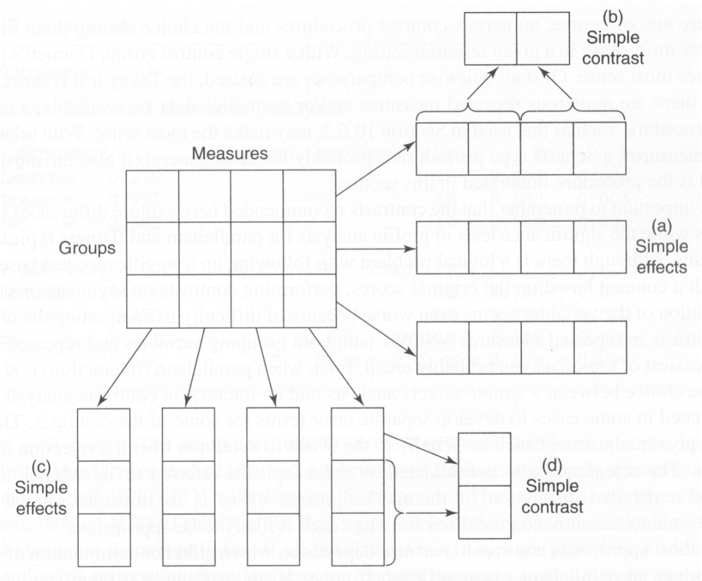
Simple effect and Simple Comparisons

Slide 62
Interactions
Whenever the parallelism hypothesis is rejected you need to pull apart the data to try and pinpoint what parts of the profile are causing the interaction

Slide 63
Interactions
Parallelism and Flatness significant, equal levels not significant
Simple effects would be used to compare the groups while holding each of the DVs constant

Slide 64
Interactions
Parallelism and Flatness significant, equal levels not significant
This is the same as doing a separate ANOVA between groups for each DV
A Scheffe adjustment is recommended if doing this post hoc
Fs=(k – 1)F(k – 1), k(n – 1)
K is number of groups and n is number of subjects

Slide 65
Interactions
Parallelism and Flatness significant, equal levels not significant
If any simple effect is significant than it should be followed by simple contrasts that can be implemented through syntax if planned or by post hoc adjustment.

Slide 66
Interactions
Parallelism and Equal levels significant, flatness not significant
This happens “rarely because if parallelism and levels are significant, flatness is nonsignificant only if profiles for different groups are mirror images that cancel each other out”.

Slide 67
Interactions
Parallelism and Equal levels significant, flatness not significant
This is done by doing a series of one-way within subjects ANOVAs for each group separately.

Slide 68
Interactions
Parallelism and Equal levels significant, flatness not significant
A Scheffe adjustment is recommended if doing this post hoc
Fs=(p – 1)F(p – 1), k(p – 1)(n – 1)
P is number of repeated measures, n is number of subjects
If any are significant, follow up with simple contrasts on the within subjects variable.

Slide 69
Interactions
If all effects are significant
Perform interaction contrasts by separating the data into smaller two by two interactions

Slide 70
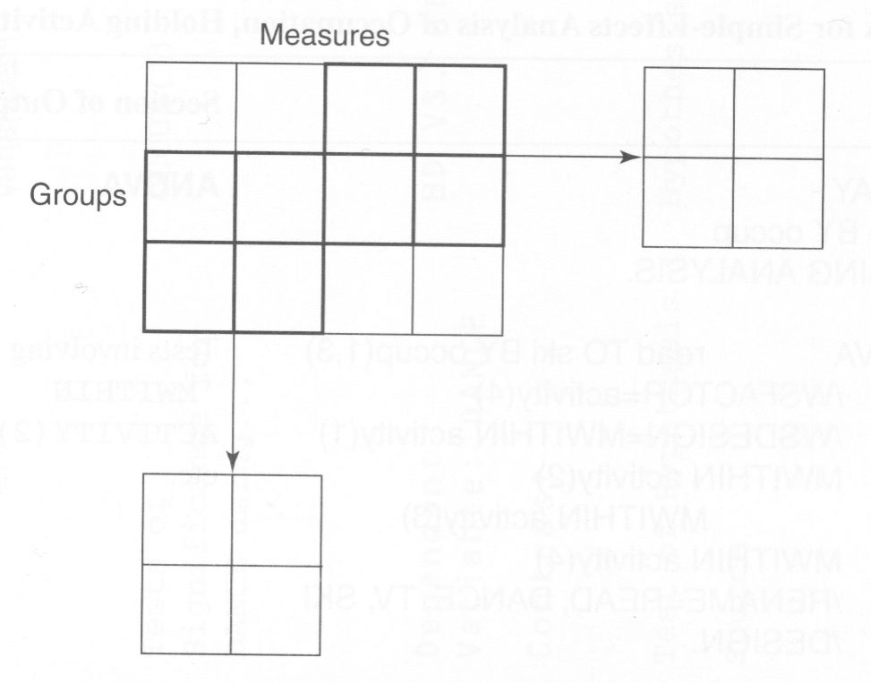
Interaction Contrasts

Slide 71
Interactions
If all effects are significant
This can be done by using the select cases function in SPSS, selecting two groups and doing a mixed ANOVA with just two of the DVs; this will break down the interaction into smaller interactions that are easier to interpret.

Slide 72
Interactions
If all effects are significant
It can also be done by averaging over groups (form comparisons on the BG variable) and averaging over DVs (form comparisons on the WG variable) and taking the interaction between them.

Slide 73
Doubly Manova

Slide 74
Doubly MANOVA
Doubly manova is a generalization of MANOVA and Profile analysis taken together in one set of data

Slide 75
Doubly MANOVA
The basic design is multiple DVs taken at multiple time points, but the multiple DVs do not have to be commensurate.
For example, students at different schools (private vs. public) are measured on basic math, reading, athleticism and IQ in grades 7 through 12.

Slide 76
Doubly MANOVA

Slide 77
Doubly MANOVA
This can be treated as a between-within (groups by time) singly multivariate design but the time effect has to meet the sphericity assumption
Sphericity can be circumvented by using both the DVs and Time in a multivariate design.

Slide 78
Doubly MANOVA
Called Doubly MANOVA because linear combinations of DVs (at each time) are linearly combined across time.
Within subjects and interaction effects are doubly multivariate while the between groups effects is singly multivariate.

Slide 79
Doubly MANOVA
This can be performed using the repeated measures ANOVA function in SPSS (now with two within subjects IVs) and just interpreting the multivariate tests.

